Slide 1
Voice Conversion Using Duration-Embedded Bi-HMMs for Expressive Speech Synthesis
Source: TRANSACTIONS ON AUDIO, SPEECH, AND LANGUAGE PROCESSING
Author : Chung-Hsien Wu, Chi-Chun Hsia, Jhing-Fa Wang
Professor : 陳嘉平
Reporter : 楊治鏞

Slide 2
Introduction
Voice conversion methods have previously been proposed to convert the speech signals uttered by a speaker to the other speaker with limited speech data.
With a limited size of speech database, this study proposes a spectral and a prosodic voice conversion model as the post-process of the TTS system for expressive speech synthesis.

Slide 3
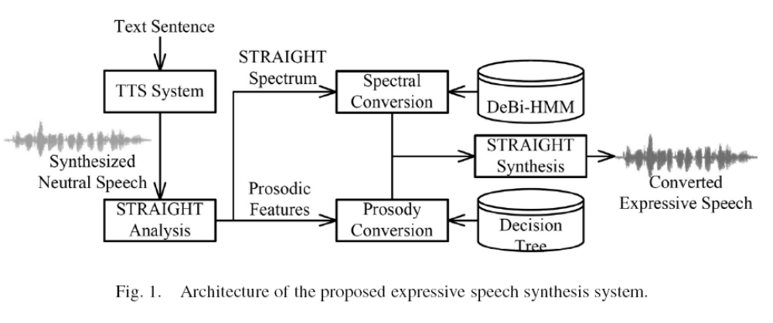

Slide 4
PROPOSED CONVERSION METHOD
The Bi-HMM is adopted to model the spectral envelope evolution of source and target speech, separately but synchronously.
The conversion function for each state is estimated with MMSE criterion under the conditional normal assumption.

Slide 5
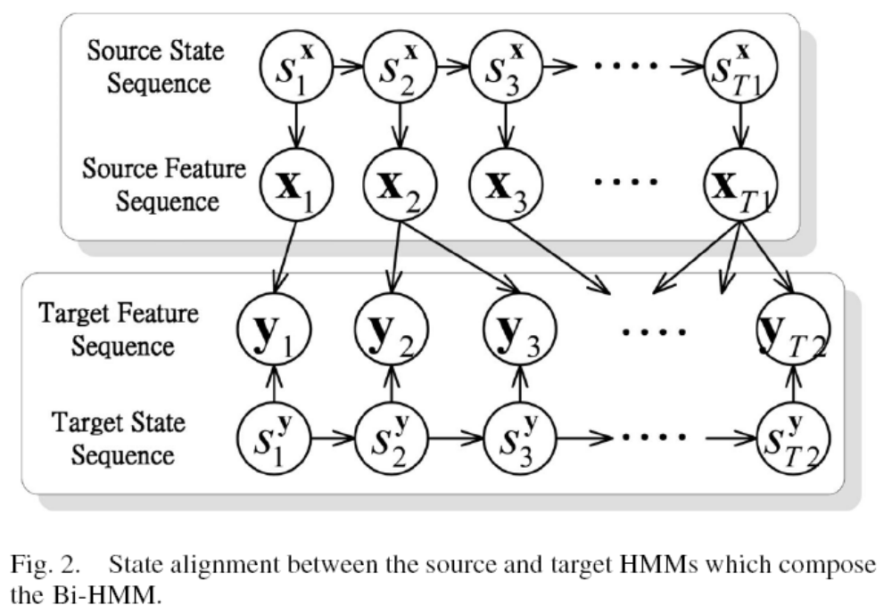
Bi-HMM Spectral Conversion Model

Slide 6





Bi-HMM Spectral Conversion Model
The upper portion depicts the relationship between the source feature vector sequence with length and its corresponding state sequence
.
The lower portion depicts the relationship between the target feature vector sequence and its corresponding state sequence .

Slide 7



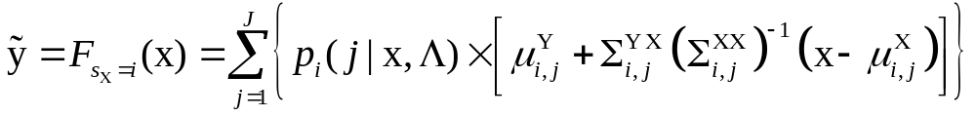





Bi-HMM Spectral Conversion Model
For a given state and an input source feature vector , the converted target vector is predicted using the following conversion function:
where denotes the number of mixture components;
and denote the mean vectors of source and target feature vector sequences in mixture of state .

Slide 8


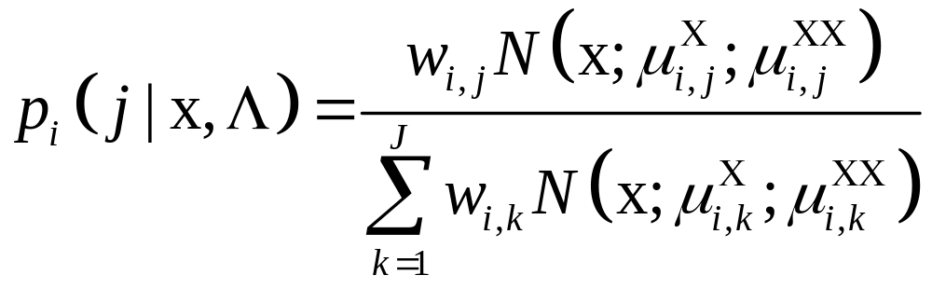
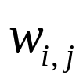
Bi-HMM Spectral Conversion Model
represents the conditional probability where belongs to the mixture in state and is estimated as
where denotes the weight of mixture in state .

Slide 9






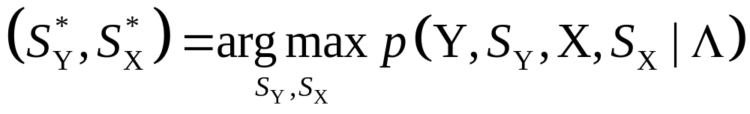
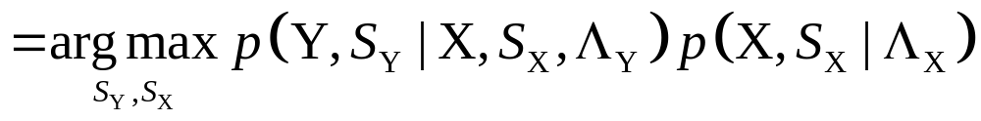
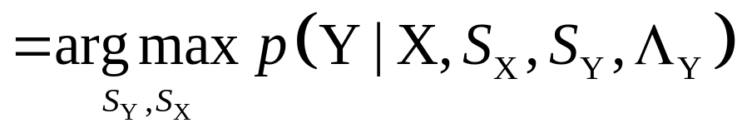
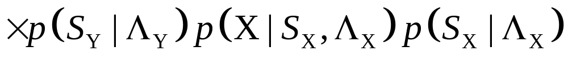
Bi-HMM Spectral Conversion Model
Given the Bi-HMM parameter set and the source and target feature vector sequences and , the state sequences and with maximum joint probability is obtained as follows:

Slide 10

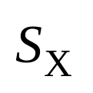
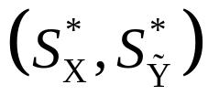
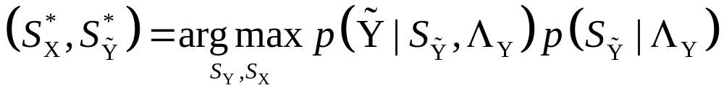
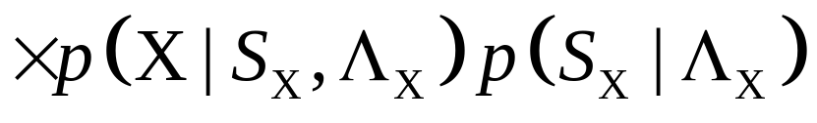
Bi-HMM Spectral Conversion Model
Given the input , a candidate target is predicted for a specific state sequence . The optimal state sequence pair in the conversion phase is obtained by

Slide 11
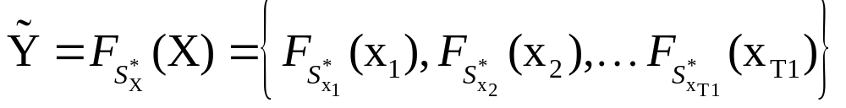
Bi-HMM Spectral Conversion Model
The target vector sequence with maximum probability in Bi-HMM is obtained by the following conversion function:

Slide 12



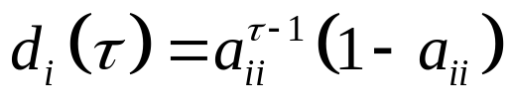
Embedded Duration Model
When the speech signal stays in state , with self-transition probability , for frames, the implicit duration probability density is a geometric distribution .
This exponential state duration density is inappropriate for most speech signals.

Slide 13
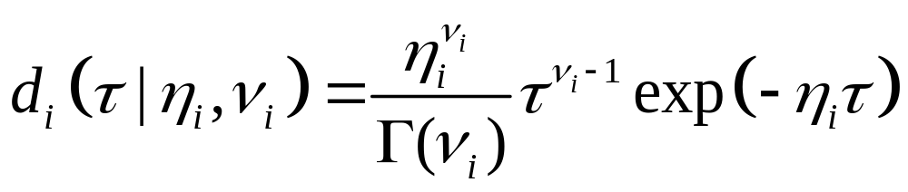

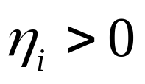
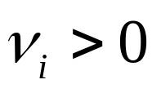
Embedded Duration Model
In this study, a Gamma duration model is adopted as follows:
where is gamma function; and are parameters of the gamma distribution.

Slide 14




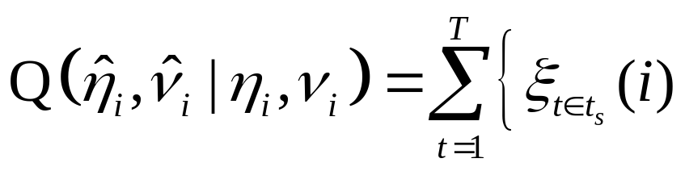
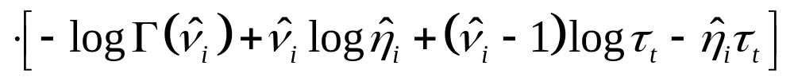


Embedded Duration Model
The E-step calculates the expectation of the log likelihood of the complete data given new estimates, and , after having the following current estimates, given by and
where is the starting frame of a state, represents the total number of frames for a training utterance

Slide 15
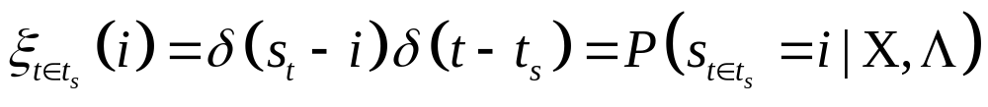
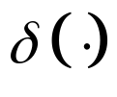

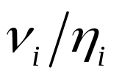
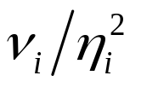
Embedded Duration Model
where is the Kronecker delta function.
Unfortunately, no closed-form solution to new estimate was derived.
Since gamma distribution contains the mean
and variance , the parameters are then derived empirically from the sample mean and variance.

Slide 16
Prosody Conversion by Decision Tree
The prosody conversion decision tree (PDT) is derived from the prosodic features of a syllable.
This work adopted the ratio of syllable duration, pitch mean, pitch dynamic range, energy mean, and energy dynamic range for prosody conversion.
Table 1 shows the linguistic question set used to train the decision tree, which includes the linguistic features in word and sentence levels.

Slide 17
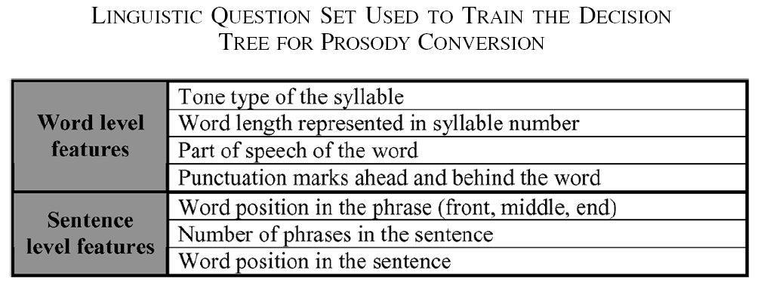

Slide 18
EXPERIMENTS
A total number of distinct tonal syllables of 1410 were used as the basic units to synthesize neutral speech.
Six expressive styles were applied, namely happiness, sadness, anger, confusion, apology, and question.

Slide 19
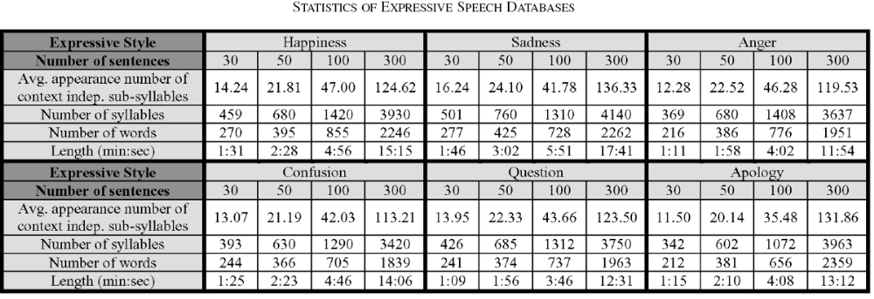

Slide 20
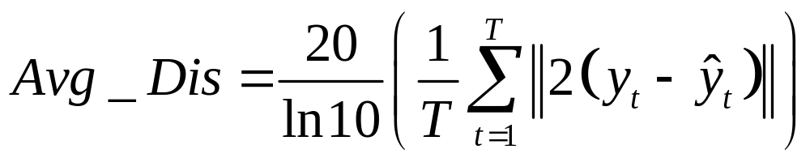


Objective test
Distortion between the converted (from neutral) and the target (happy, sad and angry) speech is calculated using the following equation:
where and denote the target and the spectrum-converted feature vectors at time.

Slide 21
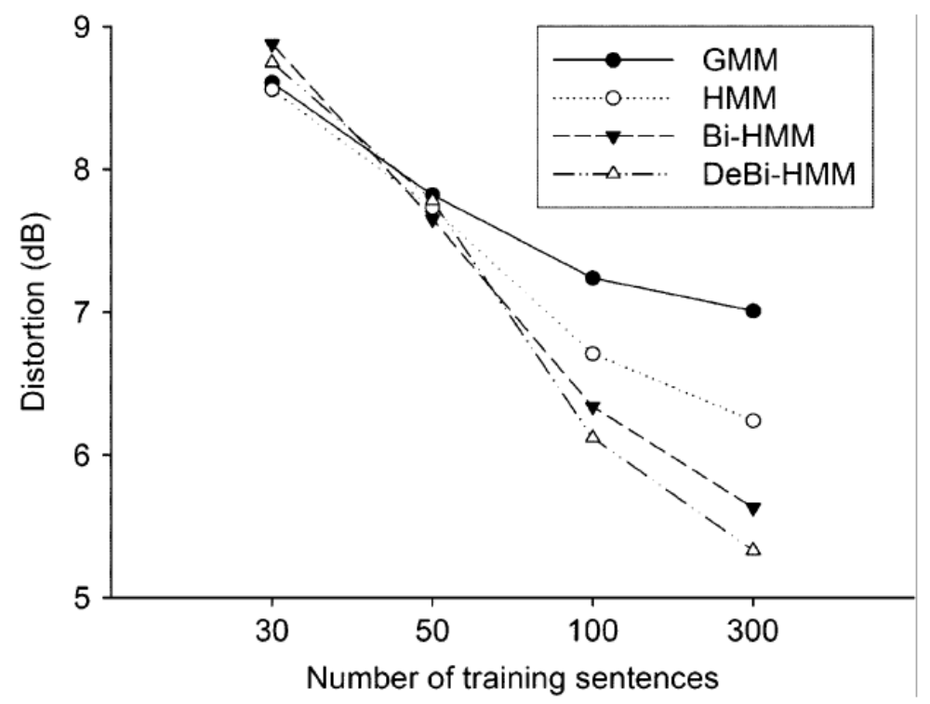

Slide 22
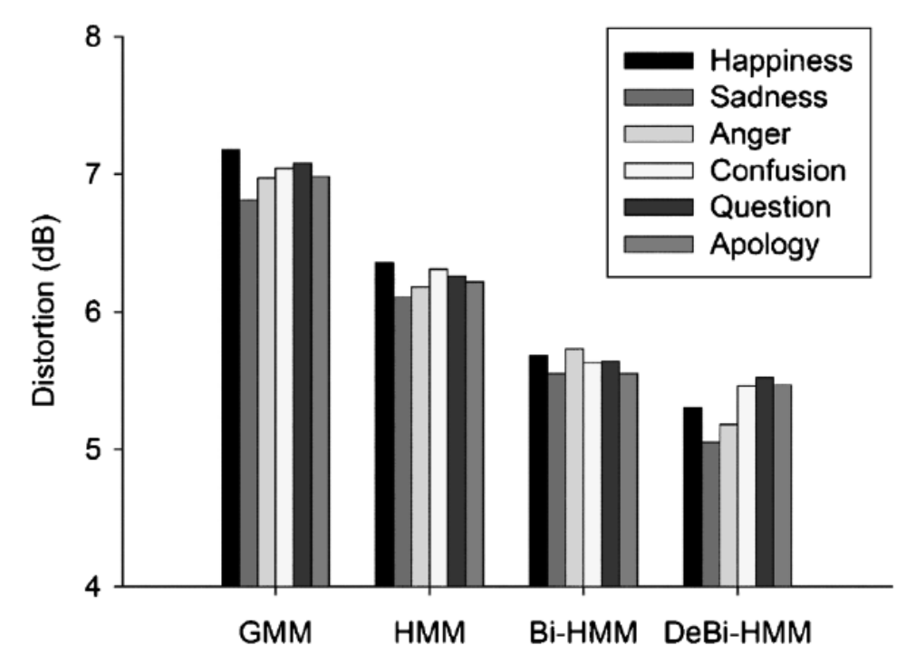

Slide 23
Subjective Test
For each test sentence randomly selected from the test set, 36 converted utterances processed by each conversion method to each expressive style were randomly output to the human subjects.
Twenty adult subjects, around 22–31 years of age, were asked to classify each utterance as one of the six expressive styles.

Slide 24
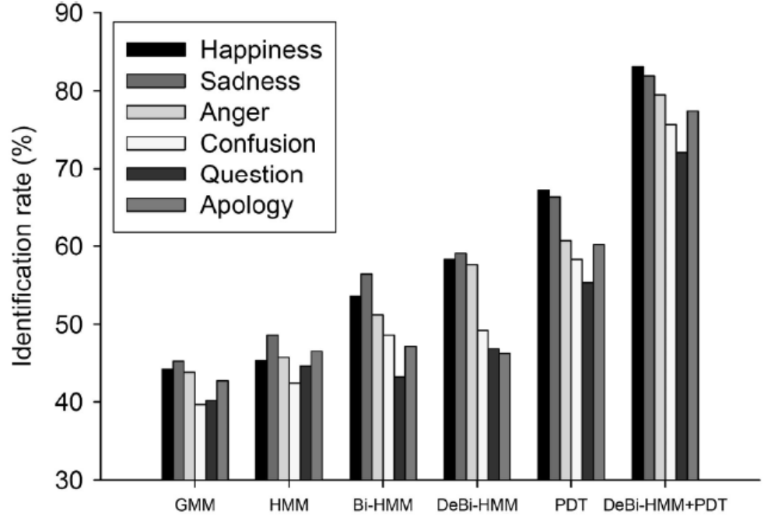

Slide 25
Subjective Test
The naturalness of the converted utterance was also evaluated, according to a 5-scale scoring method excellent very poor.

Slide 26
